Slide 1

Applied Research on House Price Prediction Using Diverse Machine Learning Techniques
SRM INSTITUTE OF SCIENCE AND TECHNOLOGY
FACULTY OF ENGINEERING AND TECHNOLOGY
DEPARTMENT OF COMPUTER SCIENCE AND ENGINEERING
15CS496L MAJOR PROJECT
Maharshi Modi
Ayush Sharma
Guide - Dr. P. Madhavan (Associate Professor)

Slide 2
Table of contents
Abstract
Introduction
Literature Survey
Inference from the survey
Objective of the Project
Challenges Involved
Architecture diagram
Modules Description
Novelty in Methodology
Equations, derivation and Algorithms used
Screen shot of the project(gui)
Results and Discussions
References
Publication details

Slide 3
Abbreviations :
AI Artificial Intelligence
ANN Artificial Neural Network
FTP False Positive Rate
GDP Gross Domestic Product
GUI Graphical User Interface
KNN K-Nearest Neighbors
ML Machine Learning
NB Naïve Bayes
ROC Receiver OperatingCharacteristics Curve
SVM Support Vector Machine
SGD Stochastic Gradient Descent
TPR True Positive Rate

Slide 4
Abstract
House price is increasing every year, a system is needed to predict the house prices in the future. House price prediction can help the developer determine the selling price of a house and can help the customer to arrange the right time to purchase a house.
The objective is prediction of residential prices for the customers considering their financial plans and needs using machine learning based techniques for Housing Price Prediction forecasting by prediction results in best accuracy.
Here the dataset is trained using various classification algorithms and then the model is tuned with classifier in order to get high accuracy.
Additionally, to compare and discuss the performance of various machine learning algorithms GUI based user interface house price prediction by attributes.
Notes:
With the booming civilization and ever-changing market specifications, it is essential to know the market drifts. Today prediction of house prices according to the trends is the principal structure of the study. It is compelling for an individual to conjecture the business trends so that he can manage his budgetary requirements according to his needs. Real Estate is an ever-growing business with an expanding society. For an investor, it is essential to comprehend the industrial drifts, which can aid him to underwrite in an accurate way and augment his business throughput. Some- times clients get dupe by the hoax market rate set up the agent due to which the real estate industry is less translucent these days. With an uptick in convince of the dataset, it’s viable for a researcher to develop a model with high accuracy. The previous model with decreased accuracy and overfitting of data reduces the efficiency, whereas the proposed system resolves such issues and renders a more reliable and enhanced model with a rich user interface. The foremost intention of this design is to promote a comprehensive design that is advantageousfor a business society as well as an individual, which is the main nub of this examination. This design is dedicated to serving a client by diminishing his fieldwork furthermore extricate his time and money. Models are acquainted in several machine learning algorithms such as Extra Tree, SVM, KNN, Naive Bayes, Logistic Regression, Stochastic Gradient Descent, and they are coupled by executing the stacking procedure.

Slide 5
Introduction
The market is evolving day by day, today a lot of software giants are shifting towards Artificial Intelligence for better decision-making and resolving some complicated difficulties in real-world using the data accessible in ample quantity.
Through this design market trends can be analyzed, and it can be a useful asset for an investor to bankroll in correct direction.
For Developing Economies Housing Sector plays a significant impact on price prediction.
Through improvised analytics and higher data with accurate prediction this project aims to develop a complete model which is useful for an individual as well as an organization and solve real time problem which could save time and money.
Notes:
Real Estate's contribution to the Indian economy is expected to be 13% of India's GDP by 2025 which would play a pivotal part in the advancement of the country. The germination in real estate grants India with its much-needed infrastructure requirements. The real estate enterprise ranks third among the 14 influential sectors of the Indian economy. Many Real Estate companies are facing breakdown in the market due to lack of such analysis and this could also lead to disruption in countries economy as Real Estate sector contributes significantly. A fallout of the real estate industry could lead to a global economic meltdown similar to the 2008 recession.
The market is evolving day by day, today a lot of software giants are shifting towards Artificial intelligence for better decision-making and resolving some complicated difficulties in real world using the data accessible in ample quantity. Today machine learning is applied in various sectors hence integrating it with the Real Estate sector can help an investor to intensify his business throughput also support an individual to shape his budgetary needs according to his requirements. For making it convenient to the majority of the people a user friendly Graphical User Interface (GUI) is deployed.
With the growth in real estate, there is a need for a model that could satisfy the business as well as individual needs. Developing a model with high throughput will provide the higher technical potential to dramatically reduce the risk of the downfall of the real estate industry with spontaneous analytics and higher accuracy of results. This project involves the implementation of an ensemble learning method to provide more accurate and precise outcome.

Slide 6
Literature Survey
S.NO. | TITLE | AUTHOR | METHODOLOGY | MERITS | DEMERITS
1 | Predicting House Price With a Memristor- Based Artificial Neural Network | J. WANG, S. G. HU, X. T. ZHAN, Q. LUO, Q. YU, ZHEN LIU, T. P. CHEN, Y. YIN, SUMIO HOSAKA, AND Y. LIU | In this paper, an ANN based on memristors is designed to learn a multi-variable regression model with a back-propagation algorithm | Enhacnes efficency and performance of model. | The use of neural networks is computationally more expensive.
2 | Predicting The Housing Price Direction using Machine learning techniques. | Debanjan Banarjee , suchibrotta Dutta. | Random forest and support vector machine algorithms are used for prediction. | Provides greater scalability , accuracy and precision throughout the system. | Long training time and extensive memory requirement.
Notes:
[1] Base Paper Link - https://ieeexplore.ieee.org/document/8310610

Slide 7
3 | A Hybrid Regression Technique for House Prices Prediction | Zengxiang L., Mong G., Sifei L., Xulei Y., Zheng Q., Rick S. | Here coupling of various regressions is performed over the features. | Prevents data overfitting & better decision making. | Noticed high bias error.
4 | A Comparison of Ensemble Methods in Financial Market Prediction | Wei Xu, Cheng Cheng, Jiajia Wang. | Highlights that when compared with random subspace and boosting, bagging provides a more stable and better improvement. | Aids the government authorities and investors to make a meticulous decision. | It does not address the barriers to implementing such a system and complexity of model increases .
5 | Property Renovations and Their Impact on House Price Index Construction | William M. Doerner, Alexander N. Bogin, | An exhaustive study that points out that pricing can be increased by fifteen percent in popular regions, while it showed inconsequential impacts on the outskirts of the city | It provides a comprehensive analysis of the influence on land prices based on location. | The results differed during the implementation of the project.

Slide 8
Inference From Survey
The examination of the literature survey on the methods of house price prediction led to various conclusions about the understanding of the systems.
During pre-processing phrases, we can infer that the detection and removal of anomalies present in the model aid to increase in efficiency and accuracy of the model.
Traditionally house hunting has been a labour extensive task draining time and money, thus it would be more prudent to use enhanced technology and procedures to carry such tasks thus saving time and raising productivity.
A few reports deduced that populous areas generally conduce to fetch higher prices in comparison to less populous areas.
Another conclusion drawn is the use of neural networks which are computationally considerably expensive and their " black box " nature can be ambiguous.

Slide 9
Objective of the Project
Develop model for predicting house price accurately in order to help customer plan for there financial needs.
Analyse the market trend and help investors to invest accordingly.
Save time and energy of a customer instead of doing fieldwork.
Area wise price prediction based on the customers requirements.
Assist an individual to plan his/her budgetary needs and help them to understand the hoax prices set up by the real estate agents to befool there customers.
User friendly Interface for wide spread use across all age group.
Develop fast and reliant data processing technique in order to process big data with minimal outliers and anomalies.

Slide 10
Challenges Involved
Initially the data was semi-structured and the data had null values which resulted in the anomalies and outliers while data processing.
Initially the dataset had some column with string and varchar datatype. In order to process data in machine learning algorithm appropriate label encoding was done for classification.
Since it’s a real time data, the area name had some common human errors and while data processing there classification lead to outliers. Hence, Classification the data of similar name was done in order to reduce the latency of the areas and filtering the data.
Model was developed in-order to withstand the real time data and fast processing of the data with high accuracy which was the main crux in order to increase the efficiency of the data processing.
Graphical User Interface(GUI) should be user friendly in order to make smooth flow of interface which is simple for all age group and GUI integration with proposed model.
Notes:
1) Initially data had null values which was dropped using drop.na() method in python. Data was formatted and structured in order to make it feasible for supervised learning.
2) Data initially had various data type such that it was difficult to feed this data in machine learning algorithm. For instance, Area column had Object datatype and it can’t be feed to machine learning algorithm since it process only numerical data. Hence a label encoder along with the looping statement was used.
3) Here in this point, it means that since it is an real time data there were some human errors in the name which lead to outliers in the classification process. For example the area used in the proposed model had Chromepet which had different names such as chrmpt, chrompt, chromept etc. Which leads to outlier.
4) Developing an application with fast data processing and validating it with high accuracy is important for any machine learning algorithm. Hence using cross validation K-fold technique data was iterated in order to process it faster.
5) User friendly Interface (GUI) was developed such that it was easy to interpret and use for all age group people and main aim of using such interface is to cover wide range of customer with different knowledge background.
6) Integrating GUI with the machine learning algorithm by taking input from the user and understanding there reequipments based model was a challenging task.
7) Aim is to cover all age group people and make it useful for all. Should be available to customer with low income in order to reach customer.

Slide 11
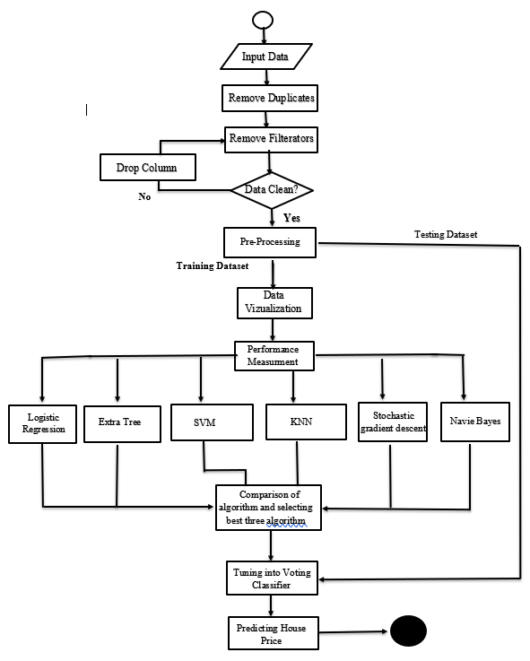
Architecture diagram
Notes:
As shown in Figure we choose the algorithms as the weak learner and using the blending function, and we calculate the final result based on the weighted average. In this framework, the process takes in two primary steps: Initially, development of base-level classifiers takes place from the dataset using several algorithms, and they are tuned into a meta-level classifier.
Now the outcomes of each and every algorithm is been noted and there performance is measured using the confusion matrix. The matrix is a performance determination table offered for the classification model on a set of data. Here various parameters like Accuracy, Precision, f1- score, Sensitivity, Specificity are been studied and there outcomes are noted. By comparing various algorithm the best three algorithm are taken as an input which are referred as weak learners.
To build stacking method, it define two things: a meta classifier that we want it to ensemble with and the weak learners L. Here the weak Learners used in this proposed framework are Logistic Regression, Extra Tree, Stochastic Gradient Descent, Naïve Bayes, SVM and K-NN. The meta classifier that we use is the voting classifier which performs soft voting to get the desired outcome in this framework.

Slide 12




Module Description
Module 1 : Data Wrangling
1. Cleaning Data and Removing Null values
2. Statistical Analysis of the Correlation
3. Importing Data and Validating structure.
Module 2 : Data Visualization and Pre-processing
1. Plotting various graphs using mat plot and seaborn
2. Analysis of Graph
3. Label Encoding
4. Performing Pre-processing
Notes:
Module 1 : Data Validation and Pre-Processing
In this section, the dataset is loaded, checked for data replication, and redundancy, after which the dataset is cleaned and trimmed to diminish data inconsistency and enhance the analysis. The dataset might incorporate missing values and null values, which can cause inconsistency and incorrect results. It is a vital undertaking to be executed to attain results with better accuracy. The primary intent of cleaning the data is to distinguish and eliminate any errors to enhance the data for decision making and analysis. Since the algorithms can process only numerical value, the categorical data inside the dataset is labelled using label encoder. The dataset accumulated is classified into two divisions: a Training set and Test set for predicting the house prices. The model constructed using different techniques of machine learning is put to the training set. The Test set checks the exactness of the model.
Module 2 : Data Visualization
Visualization of data is an analytical skill exercised in machine learning. Data visualization helps to get a detailed understanding of various attributes of datasets. Several machine learning algorithms are perceptive to the range and distribution of the characteristics. It can help identify corrupt data, outliers, and patterns. It also aids to investigate the market drifts and assist the investor to maximize this throughput. Here in our design, we have deployed several graphs to classify the key relationships which can be used to train the model. :
1) Pie chart
2) Bar plot
3) Heat Map
4) Receiver Operating Characteristic (ROC)

Slide 13
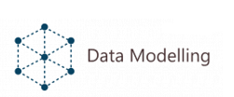
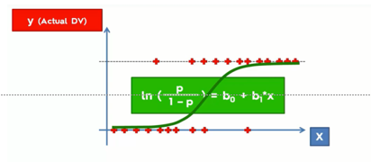
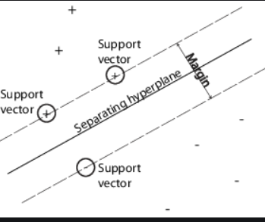
Module 3 : Logistic Regression and Support Vector Machine
Logistic Regression(LR):
1. Logistic Regression is a method to predict a dependent variable, given a set of independent variables, such independent variables are categorical.
2. Logistic Regression is a transformation of a linear regression using the Sigmoid Function.
Support vector Machine(SVM):
1. Plot each data items as a points in n-dimensional space with value of each feature being the value of coordinate. In this algorithm classification is performed by finding the hyperplane that differentiate the two classes.
2. Margin which is the sum of D⁺ (Distance from positive dataset) and D⁻ (Distance from negative dataset).
Fig. 1 Logistic Regression
Fig 2 Support Vector Machine
Notes:
Logistic Regression :
This approach aims to represent the likelihood that an occurrence materializes based on estimates of experimental variables, that could be either numerical or categorical. It strives to determine the impact of a set of variables on a binary response variable and calculates the probability of an event occurring for a randomly selected observation against the likelihood it doesn't occur. It groups findings by calculating the likely hood of an occurrence in a particular class — for example, classifying whether a website is fraudulent or not.
Sigmoid Function:
Y=1/1+e^(-x) where x is the input value, Y is the output and e is Euler's number.
The curve of the sigmoid function as shown in Figure 1, resembles as an S- shaped curve. The primary purpose of employing a sigmoid function is that it ranges within zero and one. It’s particularly beneficial for models where probability is to be predicted as an outcome and since the probability of everything ranges between zero and one, its the correct choice.
Support Vector Machine :
Here in this method, we complete the classification by defining the hyperplane amongst the characteristics. Each data item is interpreted as a point, and they are plot versus n-dimensional space such that the value of each feature being the value of a particular coordinate. Here the use of SVM is to depreciate the error rate and misclassification by recognising hyperplane with high margin from the data point. SVM are instrumental in case of high dimensional space. Individual attributes have coordinates which are formally comprehended as support vector. To accomplish the data transformation from the lower-dimensional input space towards higher dimensional input space, we use kernel function, which encourages to tackle such complex change.
Kernels are used in dataset which are not linearly separable. In python Default kernel is “rbf” (Radial Basis Function).

Slide 14
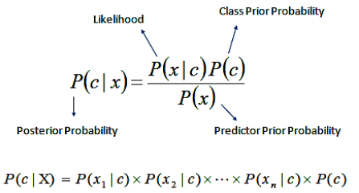
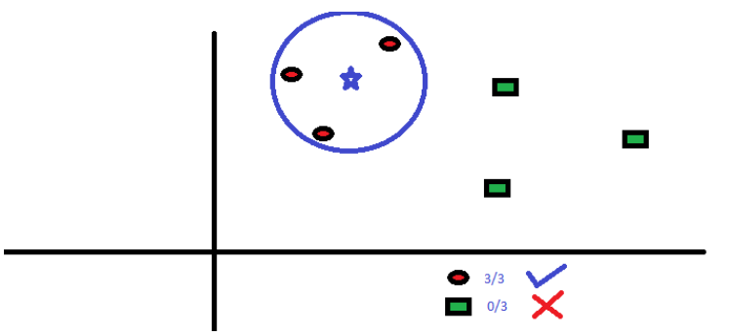
Module 4 : Naïve Bayes and K-Nearest Neighbors
Naïve Bayes (NB):
1. Bayes theorem is based on the assumption of independence among predictors. It assumes that the presence of a particular feature in a class is unrelated to any other feature.
2. Here the calculation of likelihood table takes place which can be used in the Bayes formula to get the desired probabilities after finding the frequency table.
Fig 2. Naïve Bayes Formula Fig. 2 K-Nearest Neighbor outcome
K-Nearest Neighbors (KNN):
1. K nearest neighbors is a simple algorithm that stores all available cases and classifies new cases based on a similarity measure (e.g., distance functions).
2. The KNN algorithm assumes that similar things exist in close proximity. In other words, similar things are near to each other.
Notes:
Naïve Bayes (NB):
It's a statistical classification technique used to solve problems concerning classification. It is a fast, precise, reliable algorithm and has high accuracy and speed on large datasets. Naive Bayes implies that the existence of a specific characteristic is independent of other characteristics being present. For instance, if the fruit is orange in colour, ten centimetres in diameter and round in shape, the fruit could be viewed as orange. Every one of these properties, both separately and autonomously, lead to the likelihood that the fruit is orange while paying little regard to whether they rely upon one another, and that is the reason it is called ' Naive. ‘
Bayes Theorem:
The theorem obtains the likelihood of an event taking place provided that another event has already taken place.
Its expressed by the following formula as :
P(L|M) – the likelihood of event L occurring, given event M has occurred
P(M|L) – the likelihood of event M occurring, given event L has occurred
P(L) – the likelihood of event L
P(M) – the likelihood of event M events L and M are independent of one another.
𝑃(𝐿|𝑀) = (𝑃(𝑀|𝐿)*𝑃(𝐿))/ 𝑃(𝑀)
K-Nearest Neighbors (KNN):
It is a simple, versatile and straightforward to implement supervised learning algorithm. It works on the ideology that similar observations are close to each other. It captures the concept of similarity by calculating the separation within two points on a graph. The 'k' in the algorithm is a numerical value that tells how many data points to consider for taking a vote. To classify a new point, we encircle the point with K number of datapoints and assign it to the group with the maximum number of points within the circle. The ideal way to identify the value of K is by trying out a few values of k before settling on one, which reduces the error and concurrently maintains the accuracy of the prediction. Low values can be noisy and subject to outliers. Large values of K smooth over thing but K should not be so large that other categories shall always outvote a category with a few examples.

Slide 15
Module 5: Extra Tree and Stochastic Gradient descent
Stochastic Gradient descent:
1. Gradient descent is an iterative algorithm, that starts from a random point on a function and travels down its slope in steps until it reaches the lowest point of that function.
2. In Stochastic Gradient Descent, a few samples are selected randomly instead of the whole data set for each iteration which makes it computationally less expensive.
3. Hence, in most scenarios, SGD is preferred over other types of Gradient Descent for optimizing a learning algorithm.
Extra Tree:
ExtraTreesClassifier is a type of ensemble learning method fundamentally based on decision trees.
In the Extra Trees classifier, the features and splits are selected at random, hence its also called “Extremely Randomized Tree”.
Extra tress algorithm is less computationally expensive than a Random Forest.
Notes:
Stochastic Gradient descent:
It’s a commonly used algorithm of machine learning and forms the basis of neural networks. The general concept of gradient descent in machine learning consists of sequentially adjusting parameters to decrease the cost function. There is a term called batch in Gradient Descent, which denotes the total quantity of samples from a dataset used to measure the gradient for each iteration. Typically, this batch is taken to be the whole dataset. The problem arises when the 12 dataset is huge. If we use a typical gradient descent optimization technique, we will have to use all the samples to complete one iteration while the Gradient Descent is performed, and it must be repeated for each iteration until the minimum is reached. Therefore, it becomes computationally expensive, whereas Stochastic Gradient Descent at each stage selects one case from the dataset at random instead of the whole dataset and updates gradient-based only on that single record. The benefit of it is that it's computationally less expensive, and in most scenarios, it's preferred over other gradient descent techniques for optimization.
Extra Tree:
ExtraTreesClassifier is a type of ensemble learning method fundamentally based on decision trees like Random Forest, ExtraTreesClassifier randomizes specific decisions and data subsets to reduce data overlearning and overfitting. Usually, an individual decision tree overfits the data from which it is learning because it learns from just one decision path. Estimates from only one decision tree typically do not evaluate correctly on new data. Extra-tree models reduce the likelihood of overfitting by constructing numerous trees, and it doesn't make bootstrap observations meaning it samples without replacement. Nodes are divided by random splits between a random subgroup of features selected at each node. Randomness in Extra Trees does not come from data bootstrapping, but rather from the arbitrary divisions of each finding. This contributes to less variance in the extra tree than in a random forest and decision tree.

Slide 16



Module 6 : Implementing Ensemble Learning Algorithm (Stacking Approach)
1. In the Proposed Model, concept of weak learners and meta classifiers is used. Weaker Learners are the machine learning algorithm that are used for comparison of various algorithm, and the meta learner is the voting classifiers.
2. Thereafter, top three algorithms are taken after performing the comparative analysis and they are ensembled into the voting classifier which optimizes the output and increases the throughput of the outcome.
3. In voting method each output from the different machine learning algorithm is taken as input and they are considered as ‘vote’, now the vote of each algorithm is studied and the iteration is performed for optimizing the output.
Module 7 : GUI Implementation
Python Tkinter library used for GUI.
User data is taken as input and output is displayed
Based on various requirements inputs are taken for different area.
Notes:
Ensemble Technique:
The underlying intent of any machine learning problem is to find a model that predicts the best outcome for us. Ensemble learning takes multiple machine learning algorithms into one predictive model instead of evaluating only one model and combines those models to generate one final optimized model. It's an effective way to make the model perform better.Some commonly used ensemble learning techniques are bagging, boosting, and stacking. Bagging is a meta-algorithm for machine learning, designed to boost the strength and accuracy of algorithms of machine learning used in classification and regression. This method reduces the error of variance. Whereas boosting is an iterative technique in which if an observation is incorrect, it seeks to improve the value of this observation. In general, this method decreases the bias error. Occasionally, however, they can overfit on the training dataset. Unlike bagging and boosting, stacking is typically used to merge models of different types, which leads to a reduction in either bias or variance error depending on the combining learner used. To build stacking method, we have to define two things: a meta classifier that we want it to ensemble with and the weak learners L. Here the weak Learners used in this proposed framework are Logistic Regression, Extra Tree, Stochastic Gradient Descent, Naïve Bayes, SVM and K-NN. The meta classifier that we use is the voting classifier which performs soft voting to get the desired outcome in this framework.
GUI Implementation:
The purpose of this model is to enhance the user experience by developing a rich graphical user interface. Here The dataset is checked for any null values and then data points are mapped according to the selected features for rendering greater efficiency. This allows the user to freely use and access the model built for the prediction of the house value. Python Tkinter has been used for the development of the user interface. Diverse input selection features such as the name of the locality, the number of bedrooms and the bathrooms and distance from the main road is provided for the user to select from and make an informed decision. The primary purpose of creating a Graphical user interface is to reach out to more people and minimize their fieldwork and at the same time save their time and money.

Slide 17
Novelties in methodology
The primary outlook of the project corresponds to the fact that Stacking approach with a voting classifier is used for predicting the outputs.
More than 20 different columns covering almost all aspects while choosing a house are used.
The results show that stacking achieves higher accuracy than individual classifiers and based on learning curves, it shows no signs of overfitting.
The proposed statistical model aims to use the data in real world application where integration with GUI can make its use widespread and can be accessible to all age group customers.
For developing countries were housing sector plays a major role, it is vital to develop a model that can assist government in all aspects.

Slide 18
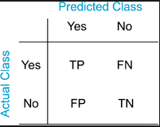
Formulas Used
Performance Measurement (Confusion Matrix):
Positive (P) : Observation are positive.
Negative (N) : Observation are negative.
True Positive (TP) : Observation are positive and are predicted to be positive.
False Negative (FN) : Observation are positive but are predicted negative.
True Negative (TN) : Observation are negative and are predicted to be negative.
False Positive (FP) : Observation are negative but are predicted positive.
Total = TP + TN + FP + FN
(i) Accuracy:
Accuracy = (TP +TN)*100 / (TP + TN + FP + FN)
(ii) Precision:
Precision = (TP *100) / (TP + FP)
(iii) Recall:
Recall = (TP)/(TP +FN)
(iv) Sensitivity:
Sensitivity = (TP * 100)/ (TP + FN)
(v) Specificity:
Sensitivity = (TN * 100)/ (TP + FN)
Notes:
Performance Measurement (Confusion Matrix):
In this model, we use confusion matrix to determine the accuracy, specificity, sensitivity, f1 factor and precision. The confusion matrix is a performance determination table offered for the classification model on a set of data. Through graph and various measures, we can actively comprehend the performance of the data. Each class reports the number of incorrect and correct prediction counts. Two primary types: Positive and Negative, have been described, and hence various outcomes are being depicted.

Slide 19
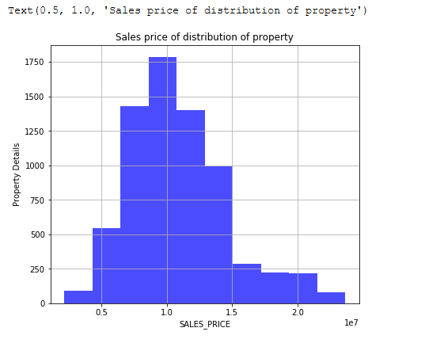
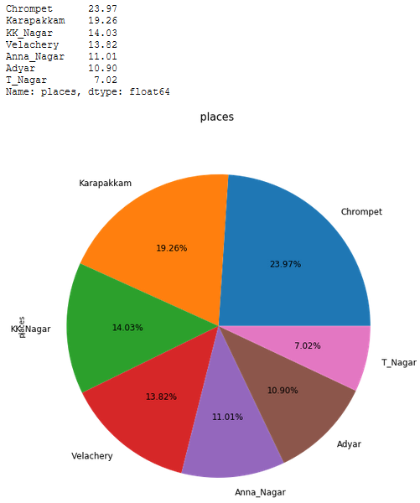
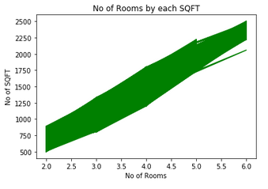
Output
Fig. 1 Sales price distribution of property
Fig. 2 Number of Rooms distribution by each SQFY
Fig 3. Distribution of Area
Notes:
The given Fig. 1 shows the relationship between the sales price, which is a portrait in the x-axis, and the square feet, which is a portrait in the y-axis. Here it shows the price distribution based on the square feet by the price distribution rates based on the given dataset. Here we can analyse that the price variation that is in the market. It could help the investor to assist him in the correct direction based on the customer specification. Extremely useful for developing economies like India where the housing sector has a significant share in the market.
Fig. 2 illustrates the Rooms distribution against the Square Feet. This is important to understand as it depicts the customers common trend and can be used by the investors to maximize the throughput.
The given Fig. 3, depicts the area distribution of the dataset based on the user requirements. Here the investor can investigate the customer's substantial house requirements and its market specification based on the customer necessities. The investor can shape the strategy based on the regions and its significance.

Slide 20
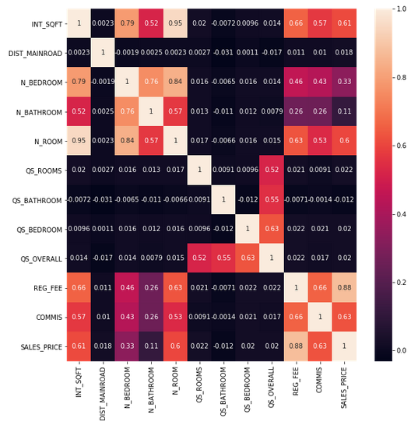
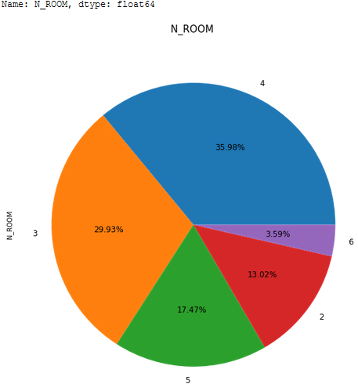
Fig 4. statistical distribution of data using heat map
Fig. 5 Classification of Rooms
Notes:
Here in the given Fig. 4, it shows the multivariate correlation amongst the other attributes. Here its primarily utilised to examine the outliers of the data and classifying fundamental relationship amongst the qualities for performing exploratory data analysis.
In Fig. 5, the correlation between the number of rooms using the pie-chart. The detailed classification of each room is made, and its active share from the entire dataset is studied. Here the user's interest share of the rooms is analysed by analysing the trends in the market according to it can help the investor to swing the cash flow which can be useful to overcome the stiff competition in the market by setting up the correct market strategy.

Slide 21
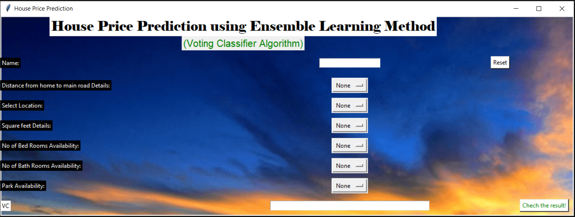
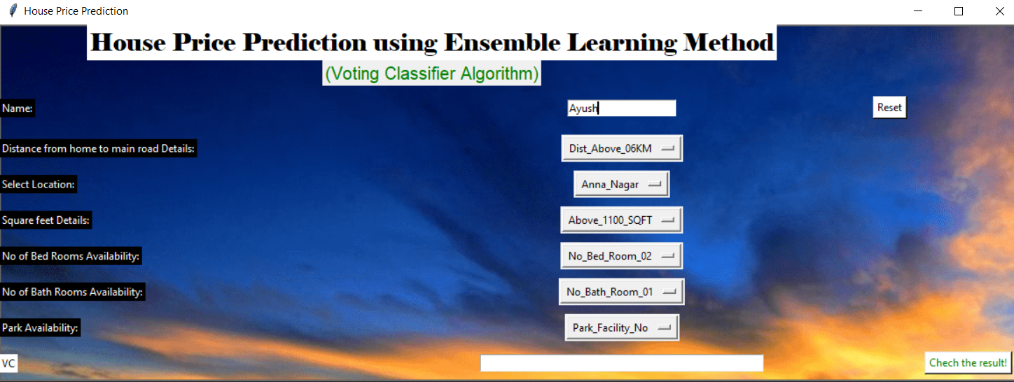
Fig. 6 User Friendly Graphical user interface for appending data according to user requirements.
Fig. 7 User friendly Graphical User Interface with user specification before processing
Notes:
1. A rich user interface is developed to enhance the user experience .
2. The graphical user interface is developed with the help of python Tkinter.
3. Multiple options are provided to the user to choose their requirements and the final outcome is generated by a voting classifier.
4. A reset button is provided to input a new value.

Slide 22
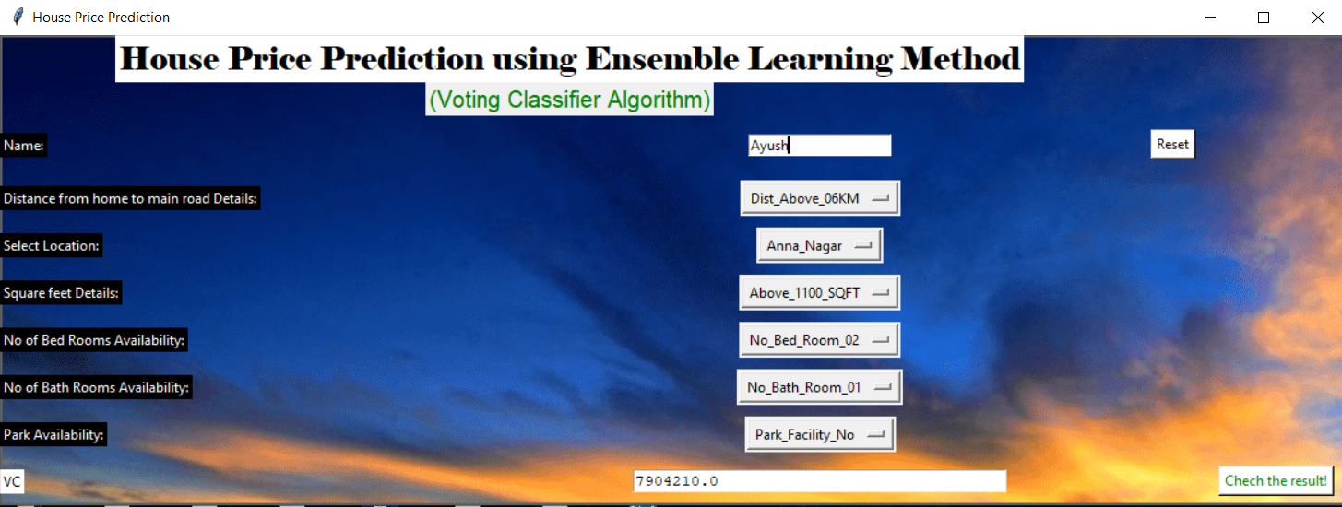
Fig. 8 Final output after processing data using the proposed model using ensemble Technique (Stacking)

Slide 23
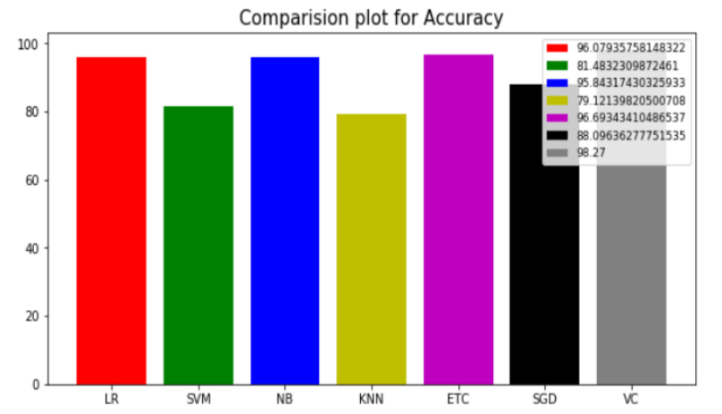
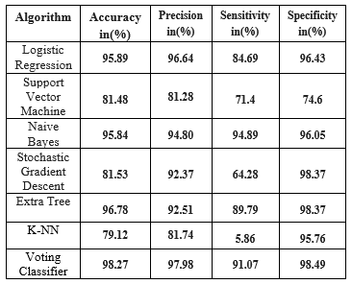
Results and Discussion
An improvement in all aspects of performance parameters was noticed with ensemble learning in comparison to other individual algorithms.
By using voting classifier we have noticed that there is an enhanced improvement in accuracy and precision.
The accuracy and precision of the voting classifier came to be 98.27% and 97.98% respectively which is greater than the output of the other individual algorithms.
Fig. 9 Comparison chart of various algorithms
Fig. 10 Comparison of various algorithms
Notes:
In order to build stacking method to we must define two things: a meta classifier that we want it to ensemble with and the weak learners L. Here the weak Learners used in this proposed framework are Logistic Regression, Extra Tree, Stochastic Gradient Descent, Naïve Bayes, SVM and K-NN. The meta classifier that we use is the voting classifier which performs soft voting in order to get desired outcome in this framework.
As shown in the Fig. 10 comparison of various machine learning algorithm along with the ensemble technique is made. By using a voting classifier, we can see that there is an improvement in the accuracy and precision is enhanced. Here the overall efficiency of the system is optimized.

Slide 24
References
[1] Ms. Ankita Gupta, Yashwant Jangid, Tushar Tiwari, Saurabh Jain, Rushab Sawant ―A Multi Feature-Based Housing Price Prediction for Indian Market Using Machine Learning, ISSN 2347 – 8527, IJCMS December 2017
[2] William M. Doerner, Alexander N. Bogin, ―Property Renovations and Their Impact on House Price Index Construction‖,https://www.fhfa.gov/PolicyProgramsRe search/Research/PaperDocuments/wp1702.pdf
[3] KANG Ling-Wei and D. X. Zhu, ―The Land Prices and Housing Prices —— Empirical Research Based on Panel Data of 11 Provinces and Municipalities in Eastern China, 2013 International Conference on Management Science & Engineering (20th) July 17- 19, 2013.
[4] Susmita Ray, ―A Quick Review of Machine Learning Algorithms. International Conference on Machine Learning, Big Data, Cloud and Parallel Computing, India, 2019
[5] Suchibrota Dutta, Debanjan Banerjee, ―Predicting the Housing Price Direction using Machine Learning Techniques‖, 2017 IEEE ICPCSI
[6] Rohini Nair, Abhijit Sarma, Sagar Doshi, Ayush Varma, ―House Price Prediction Using Machine Learning And Neural Networks‖, 2018 Inventive Communication and Computational Technologies
[7] Zengxiang L., Mong G., Sifei L., Xulei Y., Zheng Q., Rick S., ―A Hybrid Regression Technique for House Prices Prediction‖, IEEE IEEM International Conference(2017)DOI: 10.1109/IEEM.2017.8289904
[8] Yajuan Tang, Pengcheng G., Shuang Qiu, ―Predicting Housing Price Based on Ensemble Learning Algorithm‖, IEEE IDAP (2018) DOI: 10.1109/IDAP.2018.8620781.
[9] Wei Xu, Cheng Cheng, Jiajia Wang, ―A Comparison of Ensemble Methods in Financial Market Prediction‖, IJCCSO 2012 International Joint Conference on Computational Sciences and Optimization
[10] Supriya Mandhare, Snehal Kathale, Chanda Chouhan, ―Industrial Revolution and Artificial Intelligent‖, International Journal of Engineering Research & Technology ISSN: 2278-0181 ICIATE – 2017

Slide 25
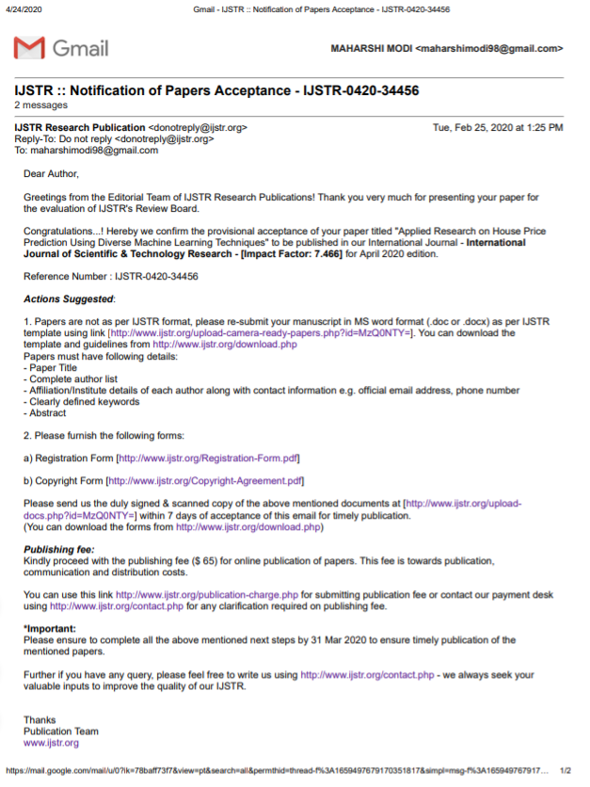
Publication Detail
Notes:
Reference Link :
http://www.ijstr.org/final-print/apr2020/Applied-Research-On-House-Price-Prediction-Using-Diverse-Machine-Learning-Techniques.pdf

Slide 26
Software Requirements:
Operating System : Windows 7 or above, macOS X 10.11 or higher, Linux: RHEL 6/7
Tools : Anaconda with Jupyter Notebook v3.8.2 (Individual Edition)
Architecture : x86 32-bit CPU(Intel/AMD architecture)
Python version : 3.7.3
Hardware requirements:
Processor : Core i5 or above
Hard disk : minimum 80 GB
RAM : minimum 4 GB
Work distribution for the proposed model:
Using SRM facilities : 40 %
Using External Facilities : 60%
Changes Made in Lockdown:
User Interface modification
Adding More attributes for better experience
Receiver operating characteristic curve (ROC) for visualization of false positive and True positive rates.
Notes:
Software Requirements:
1. The Jupyter Notebook is an open source web application that you can use to create and share documents that contain live code, equations, visualizations, and text.
2. A 32-bit operating system is a minimum requirement, for optimum results 64-bit operating system is needed.
Hardware requirements:
1. Internet access to download the files from Cloud or a USB drive containing all of the files you need .
2. A minimum of 10GB free disk space.
Work Distribution For the Proposed Model :
1) Using SRM Facilities :
a. IEEE reference for previous IEEE research paper extraction
b. SRM CSE library resources
c. Guide consultation
2) Using External Facilities :
a. dataset
b. Jupyter Notebook tool, Article references
c. Area wise study for data validation
d. Coursera for learning purposes.

